Slide 2
Federal Actions

Slide 3
Federal Actions
Federal Legislation
Regulations
Executive Actions
Budget Reconciliation

Slide 4
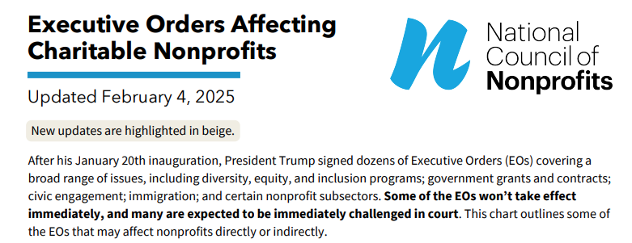
Executive Orders

Slide 5
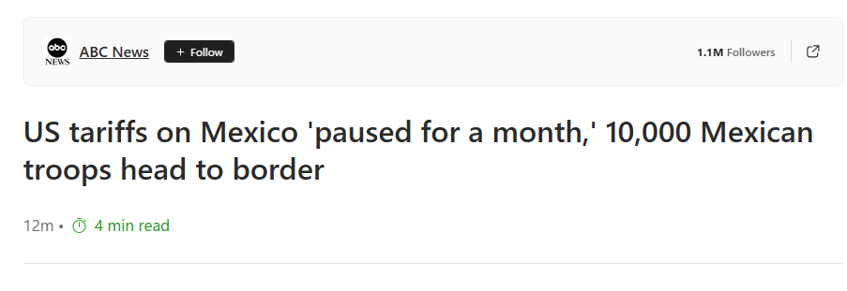
Pay attention to what HAPPENS, not what is SAID

Slide 6
Things to Watch for
Phrases like: DEIA, “Immutable characteristics”
Freezes and Rollbacks
Appeals to SCOTUS

Slide 7
Executive Orders
(I/DD Impact)
Title | DD Impact
Establishing And Implementing The President's "Department Of Government Efficiency" | **May have** ended Department of Education. If some of those activities aren’t replaced, that’s problematic. But many of the funding can be replaced with Block Grants
Ending Radical And Wasteful Government DEI Programs And Preferencing | Ends DEI programs among FEDERAL AGENCIES who've provided DEI training or advance DEI, DEIA, or environmental justice priorities
Reforming The Federal Hiring Process And Restoring Merit To Government Service | Changes federal hiring processes to end focus on various groups
Ending Illegal Discrimination And Restoring Merit-Based Opportunity | Ends DEI programs in the Federal government and for grantees and contractors.
Immediate Assessment of Aviation Safety | Criticizes Biden for recruiting people with I/DD, investigates FAA hiring practices, and replaces unqualified employees
Protecting Children from Chemical and Surgical Mutilation | Expands the process of ending funding for healthcare providers
Expanding Educational Freedom and Opportunity for Families | Will allow charter schools or vouchers in every state
Notes:
I am further ordering the Secretary of Transportation (Secretary) and the Administrator of the Federal Aviation Administration (Administrator) to review all hiring decisions and changes to safety protocols made during the prior 4 years, and to take such corrective action as necessary to achieve uncompromised aviation safety, including the replacement of any individuals who do not meet qualification standards. This review shall include a systematic assessment of any deterioration in hiring standards and aviation safety standards and But the Biden Administration egregiously rejected merit-based hiring, requiring all executive departments and agencies to implement dangerous “diversity equity and inclusion” tactics, and specifically recruiting individuals with “severe intellectual” disabilities in the FAA. protocols during the Biden Administration.... Consistent with the Presidential Memorandum of January 21, 2025, the Secretary and the Administrator shall take all actions necessary to reverse concerning safety and personnel trends during the prior 4 years, instill an unwavering commitment to aviation safety, and ensure that all Americans fly with peace of mind.I ordered an immediate return to merit-based recruitment, hiring, and promotion, elevating safety and ability as the paramount standard. Yesterday’s devastating accident tragically underscores the need to elevate safety and competence as the priority of the FA
Sec. 3. Guidance on Supporting State-based K-12 Educational Choice. Within 60 days of the date of this order, the Secretary of Education shall issue guidance regarding how States can use Federal formula funds to support K-12 educational choice initiatives. Sec. 4. Encouraging Education Freedom through Discretionary Grant Programs. (a) The Secretary of Education shall include education freedom as a priority in discretionary grant programs, as appropriate and consistent with applicable law. (b) Within 90 days of the date of this order, the Secretary of Labor and the Secretary of Education shall review their respective discretionary grant programs and each submit a plan to the President, through the Assistant to the President for Domestic Policy, that identifies, evaluates, and makes recommendations regarding using relevant discretionary grant programs to expand education freedom for America’s families and teachers. Sec. 5. Expanding Opportunities for Low-Income, Working Families. Within 90 days of the date of this order, the Secretary of Health and Human Services shall issue guidance regarding whether and how States receiving block grants for families and children from the Department, including the Child Care and Development Block Grant (CCDGB), can use them to expand educational choice and support families who choose educational alternatives to governmental entities, including private and faith-based options. Sec. 6. Helping Military Families. Within 90 days of the date of this order, the Secretary of Defense shall review any available mechanisms under which military-connected families may use funds from the Department of Defense to attend schools of their choice, including private, faith-based, or public charter schools, and submit a plan to the President describing such mechanisms and the steps that would be necessary to implement them beginning in the 2025-26 school year. Sec. 7. Helping Children Eligible for Bureau of Indian Education (BIE) Schools. Within 90 days of the date of this order, the Secretary of the Interior shall review any available mechanisms under which families of students eligible to attend BIE schools may use their Federal funding for educational options of their choice, including private, faith-based, or public charter schools, and submit a plan to the President describing such mechanisms and the steps that would be necessary to implement them for the 2025-26 school year. The Secretary shall report on the current performance of BIE schools and identify educational options in nearby areas. Sec. 8. General Provisions. (a) Nothing in this order shall be construed to impair or otherwise affect: (i) the authority granted by law to an executive department or agency, or the head thereof; or (ii) the functions of the Director of the Office of Management and Budget relating to budgetary, administrative, or legislative proposals. (b) This order shall be implemented consistent with applicable law and subject to the availability of appropriations. (c) This order is not intended to, and does not, create any right or benefit, substantive or procedural, enforceable at law or in equity by any party against the United States, its departments, agencies, or entities, its officers, employees, or agents, or any other person.

Slide 8
Executive Memorandum
(I/DD Impact)
Title | DD Impact
Regulatory Freeze Pending Review | Freezes or postpones all unpublished or not-yet-effective rules Rules sent to the Federal Register but not yet published must be withdrawn for review, with same emergency exceptions applying. "Rule" includes traditional rules (5 USC 551(4)), regulatory actions (EO 12866), guidance documents (EO 13891), notices of inquiry, advance notices, and agency statements of general applicability.
Restoring Accountability for Career Senior Executives | Expands the types of Federal employees that the president can fire Expands the type of reasons the president can fire Federal employees
Freezing all Federal Financial Assistance and Grants | Freezes every Federal financial assistance and grant not providing direct service to people Later limited to spending related to DEI, Environmental Justice, or related programs
10-To-1 Deregulation Initiative | Whenever an agency issues a rule, reg, or guidance, it must cut 10.
MEMORANDUM FOR THE HEADS OF EXECUTIVE DEPARTMENTS AND AGENCIES | Review all funding that agencies provide to NGOs, and align future funding decisions with the Presidents Goals
Notes:
All new rules need approval from post-January 20, 2025 department/agency heads before issuance, though this power can be delegated and the OMB Director can exempt emergency cases or urgent deadlines.
Rules sent to the Federal Register but not yet published must be withdrawn for review, with same emergency exceptions applying.
Published or issued but not-yet-effective rules should undergo 60-day postponement for review, during which agencies can open comment periods and reassess petitions; further delays possible if needed.
After the 60-day review, rules without substantial questions need no action, while those raising concerns require OMB Director consultation.
"Rule" includes traditional rules (5 USC 551(4)), regulatory actions (EO 12866), guidance documents (EO 13891), notices of inquiry, advance notices, and agency statements of general applicability.
OMB Director oversees implementation, handles all related communications, and can review/act on pending Paperwork Reduction Act information collections.
Memorandum may be modified if pre-January 20, 2025 actions are found undermining its purpose; must be implemented within legal bounds.
CopyRetryClaude can make mistakes. Please double-check responses.https://www.whitehouse.gov/presidential-actions/2025/01/regulatory-freeze-pending-review/

Slide 9
Secretarial Memoranda
(I/DD Impact)
Title | DD Impact
OPM Memo: Further Guidance Regarding Ending DEIA Offices, Programs and Initiative | On 2/5 – OPM issued a memo instructing federal agencies to eliminate DEIA offices, policies, programs, and practices. They are to “retain the minimum number of employees necessary to ensure agency compliance with applicable disability and accessibility laws.”
Capping Indirect Cost Rates for NIH Grants | Unsure, but may lead to institutions like University of Kentucky receiving up to $80 million less in annual funding
Notes:
All new rules need approval from post-January 20, 2025 department/agency heads before issuance, though this power can be delegated and the OMB Director can exempt emergency cases or urgent deadlines.
Rules sent to the Federal Register but not yet published must be withdrawn for review, with same emergency exceptions applying.
Published or issued but not-yet-effective rules should undergo 60-day postponement for review, during which agencies can open comment periods and reassess petitions; further delays possible if needed.
After the 60-day review, rules without substantial questions need no action, while those raising concerns require OMB Director consultation.
"Rule" includes traditional rules (5 USC 551(4)), regulatory actions (EO 12866), guidance documents (EO 13891), notices of inquiry, advance notices, and agency statements of general applicability.
OMB Director oversees implementation, handles all related communications, and can review/act on pending Paperwork Reduction Act information collections.
Memorandum may be modified if pre-January 20, 2025 actions are found undermining its purpose; must be implemented within legal bounds.
CopyRetryClaude can make mistakes. Please double-check responses.https://www.whitehouse.gov/presidential-actions/2025/01/regulatory-freeze-pending-review/

Slide 10
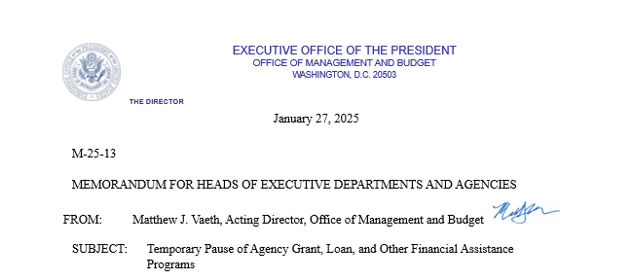
Federal Aid Freeze
Key Parts:
Excludes Medicare and Social Security
“Including but not limited to…”
Requires agencies answer 14 questions
Notes:
All new rules need approval from post-January 20, 2025 department/agency heads before issuance, though this power can be delegated and the OMB Director can exempt emergency cases or urgent deadlines.
Rules sent to the Federal Register but not yet published must be withdrawn for review, with same emergency exceptions applying.
Published or issued but not-yet-effective rules should undergo 60-day postponement for review, during which agencies can open comment periods and reassess petitions; further delays possible if needed.
After the 60-day review, rules without substantial questions need no action, while those raising concerns require OMB Director consultation.
"Rule" includes traditional rules (5 USC 551(4)), regulatory actions (EO 12866), guidance documents (EO 13891), notices of inquiry, advance notices, and agency statements of general applicability.
OMB Director oversees implementation, handles all related communications, and can review/act on pending Paperwork Reduction Act information collections.
Memorandum may be modified if pre-January 20, 2025 actions are found undermining its purpose; must be implemented within legal bounds.
CopyRetryClaude can make mistakes. Please double-check responses.https://www.whitehouse.gov/presidential-actions/2025/01/regulatory-freeze-pending-review/

Slide 11
Federal Aid Freeze
14 Questions To Be Unfrozen
1. Please identify the email of the senior political appointee responsible for overseeing this program"
2. Does the program have any pending funding announcements?"
3. Does the program have any anticipated obligations or disbursement of funds before 3/15/2025?"
4. Does this program have any statutory requirements mandating the obligation or disbursement of funds through 3/15/2025?"
5. Provide the estimated date of the next obligation or disbursement of funds"
6. Does this program provide Federal funding to nongovernmental Organizations supporting or providing services, either directly or indirectly, to removable or illegal aliens?"
7. Is this program a foreign assistance program, or provide funding or support activities overseas?"
8. Does this program provide funding that is implicated by the revocation and recission of the U.S. International Climate Finance Plan?
9. Does this program include activities that impose an undue burden on the identification, development, or use of domestic energy resources (including through funding under the Inflation Reducing Act of 2022; and the Infrastructure Investment and Jobs Act)?
10. Does this program provide funding that is implicated by the directive to end discriminatory programs, including illegal DEI and “diversity, equity, inclusion, and accessibility” (DEIA) mandates, policies, programs, preferences, and activities, under whatever name they appear, or other directives in the same EO, including those related to “environmental justice” programs or “equity-related” grants?
11. Does this program promote gender ideology?"
12. Does this program promote or support in any way abortion or other related activities identified in the Hyde Amendment?
13. If not covered in the preceding columns, does this program support any activities that must not be supported based on executive orders issued on or after January 20, 2025 (including executive orders released following the dissemination of this spreadsheet)?
14. Provide additional information on program or project activities"
Notes:
All new rules need approval from post-January 20, 2025 department/agency heads before issuance, though this power can be delegated and the OMB Director can exempt emergency cases or urgent deadlines.
Rules sent to the Federal Register but not yet published must be withdrawn for review, with same emergency exceptions applying.
Published or issued but not-yet-effective rules should undergo 60-day postponement for review, during which agencies can open comment periods and reassess petitions; further delays possible if needed.
After the 60-day review, rules without substantial questions need no action, while those raising concerns require OMB Director consultation.
"Rule" includes traditional rules (5 USC 551(4)), regulatory actions (EO 12866), guidance documents (EO 13891), notices of inquiry, advance notices, and agency statements of general applicability.
OMB Director oversees implementation, handles all related communications, and can review/act on pending Paperwork Reduction Act information collections.
Memorandum may be modified if pre-January 20, 2025 actions are found undermining its purpose; must be implemented within legal bounds.
CopyRetryClaude can make mistakes. Please double-check responses.https://www.whitehouse.gov/presidential-actions/2025/01/regulatory-freeze-pending-review/

Slide 12
Federal Aid Freeze Takeaways
The intent, probably, was to implement previous Executive Order’s banning DEI funding in the government
The wording made it too broad
The court challenges will probably make it to Supreme Court
Notes:
All new rules need approval from post-January 20, 2025 department/agency heads before issuance, though this power can be delegated and the OMB Director can exempt emergency cases or urgent deadlines.
Rules sent to the Federal Register but not yet published must be withdrawn for review, with same emergency exceptions applying.
Published or issued but not-yet-effective rules should undergo 60-day postponement for review, during which agencies can open comment periods and reassess petitions; further delays possible if needed.
After the 60-day review, rules without substantial questions need no action, while those raising concerns require OMB Director consultation.
"Rule" includes traditional rules (5 USC 551(4)), regulatory actions (EO 12866), guidance documents (EO 13891), notices of inquiry, advance notices, and agency statements of general applicability.
OMB Director oversees implementation, handles all related communications, and can review/act on pending Paperwork Reduction Act information collections.
Memorandum may be modified if pre-January 20, 2025 actions are found undermining its purpose; must be implemented within legal bounds.
CopyRetryClaude can make mistakes. Please double-check responses.https://www.whitehouse.gov/presidential-actions/2025/01/regulatory-freeze-pending-review/

Slide 13
What does this mean for Kentucky?
Notes:
All new rules need approval from post-January 20, 2025 department/agency heads before issuance, though this power can be delegated and the OMB Director can exempt emergency cases or urgent deadlines.
Rules sent to the Federal Register but not yet published must be withdrawn for review, with same emergency exceptions applying.
Published or issued but not-yet-effective rules should undergo 60-day postponement for review, during which agencies can open comment periods and reassess petitions; further delays possible if needed.
After the 60-day review, rules without substantial questions need no action, while those raising concerns require OMB Director consultation.
"Rule" includes traditional rules (5 USC 551(4)), regulatory actions (EO 12866), guidance documents (EO 13891), notices of inquiry, advance notices, and agency statements of general applicability.
OMB Director oversees implementation, handles all related communications, and can review/act on pending Paperwork Reduction Act information collections.
Memorandum may be modified if pre-January 20, 2025 actions are found undermining its purpose; must be implemented within legal bounds.
CopyRetryClaude can make mistakes. Please double-check responses.https://www.whitehouse.gov/presidential-actions/2025/01/regulatory-freeze-pending-review/

Slide 14
Congressional Budget
Notes:
All new rules need approval from post-January 20, 2025 department/agency heads before issuance, though this power can be delegated and the OMB Director can exempt emergency cases or urgent deadlines.
Rules sent to the Federal Register but not yet published must be withdrawn for review, with same emergency exceptions applying.
Published or issued but not-yet-effective rules should undergo 60-day postponement for review, during which agencies can open comment periods and reassess petitions; further delays possible if needed.
After the 60-day review, rules without substantial questions need no action, while those raising concerns require OMB Director consultation.
"Rule" includes traditional rules (5 USC 551(4)), regulatory actions (EO 12866), guidance documents (EO 13891), notices of inquiry, advance notices, and agency statements of general applicability.
OMB Director oversees implementation, handles all related communications, and can review/act on pending Paperwork Reduction Act information collections.
Memorandum may be modified if pre-January 20, 2025 actions are found undermining its purpose; must be implemented within legal bounds.
CopyRetryClaude can make mistakes. Please double-check responses.https://www.whitehouse.gov/presidential-actions/2025/01/regulatory-freeze-pending-review/

Slide 15
Budget Reconciliation
Projecting more than $2 trillion in cuts
Included is per capita caps on Medicaid for states
Work requirements for SNAP
Eliminating BBCE
Repealing Access Rule
Notes:
All new rules need approval from post-January 20, 2025 department/agency heads before issuance, though this power can be delegated and the OMB Director can exempt emergency cases or urgent deadlines.
Rules sent to the Federal Register but not yet published must be withdrawn for review, with same emergency exceptions applying.
Published or issued but not-yet-effective rules should undergo 60-day postponement for review, during which agencies can open comment periods and reassess petitions; further delays possible if needed.
After the 60-day review, rules without substantial questions need no action, while those raising concerns require OMB Director consultation.
"Rule" includes traditional rules (5 USC 551(4)), regulatory actions (EO 12866), guidance documents (EO 13891), notices of inquiry, advance notices, and agency statements of general applicability.
OMB Director oversees implementation, handles all related communications, and can review/act on pending Paperwork Reduction Act information collections.
Memorandum may be modified if pre-January 20, 2025 actions are found undermining its purpose; must be implemented within legal bounds.
CopyRetryClaude can make mistakes. Please double-check responses.https://www.whitehouse.gov/presidential-actions/2025/01/regulatory-freeze-pending-review/

Slide 16
Medicaid Per Capita Caps
Medicaid Per Capita Caps
Up to $900 billion in 10-year savings
VIABILITY: HIGH / MEDIUM / LOW
• Currently, states receive open-ended Federal Medicaid matching funds based on
the costs of providing services to enrollees. Under Medicaid today, for every
dollar a state spends on Medicaid services, it gets $1 to $3 of Federal support
(richer states get $1, poorer states get $3). States are guaranteed continued
federal support for actual spending, even if those costs go up or do not achieve
desired outcomes. With a per capita cap, the federal government makes a limited
payment to the state based on a preset formula, which does not increase based
on actual costs. States exceeding the “cap” for enrollees would thus need to find
other revenues to maintain spending levels or explore innovative ways to reduce
excessive costs. This policy would establish a per capita cap for each of the
different enrollment populations set to grow at medical inflation.
Notes:
All new rules need approval from post-January 20, 2025 department/agency heads before issuance, though this power can be delegated and the OMB Director can exempt emergency cases or urgent deadlines.
Rules sent to the Federal Register but not yet published must be withdrawn for review, with same emergency exceptions applying.
Published or issued but not-yet-effective rules should undergo 60-day postponement for review, during which agencies can open comment periods and reassess petitions; further delays possible if needed.
After the 60-day review, rules without substantial questions need no action, while those raising concerns require OMB Director consultation.
"Rule" includes traditional rules (5 USC 551(4)), regulatory actions (EO 12866), guidance documents (EO 13891), notices of inquiry, advance notices, and agency statements of general applicability.
OMB Director oversees implementation, handles all related communications, and can review/act on pending Paperwork Reduction Act information collections.
Memorandum may be modified if pre-January 20, 2025 actions are found undermining its purpose; must be implemented within legal bounds.
CopyRetryClaude can make mistakes. Please double-check responses.https://www.whitehouse.gov/presidential-actions/2025/01/regulatory-freeze-pending-review/

Slide 17
Lower Medicaid Matching Rate Floor
Lower Medicaid Matching Rate Floor
Up to $387 billion in 10-year savings
VIABILITY: HIGH / MEDIUM / LOW
There is currently a floor for states’ federal medical assistance percentage
(FMAP) set in statute at 50%. This option would lower the floor and allow all
states’ FMAPs to be set according to the formula. This option would primarily
impact high-income states, like California and New York.
Notes:
All new rules need approval from post-January 20, 2025 department/agency heads before issuance, though this power can be delegated and the OMB Director can exempt emergency cases or urgent deadlines.
Rules sent to the Federal Register but not yet published must be withdrawn for review, with same emergency exceptions applying.
Published or issued but not-yet-effective rules should undergo 60-day postponement for review, during which agencies can open comment periods and reassess petitions; further delays possible if needed.
After the 60-day review, rules without substantial questions need no action, while those raising concerns require OMB Director consultation.
"Rule" includes traditional rules (5 USC 551(4)), regulatory actions (EO 12866), guidance documents (EO 13891), notices of inquiry, advance notices, and agency statements of general applicability.
OMB Director oversees implementation, handles all related communications, and can review/act on pending Paperwork Reduction Act information collections.
Memorandum may be modified if pre-January 20, 2025 actions are found undermining its purpose; must be implemented within legal bounds.
CopyRetryClaude can make mistakes. Please double-check responses.https://www.whitehouse.gov/presidential-actions/2025/01/regulatory-freeze-pending-review/

Slide 18
Establish Medicaid Work Requirements
Establish Medicaid Work Requirements
$100 billion in 10-year savings
VIABILITY: HIGH / MEDIUM / LOW
The policy would restore the dignity of work by implementing work requirements
for able-bodied adults without dependents to qualify for Medicaid coverage, as
included in the House-passed Limit, Save, Grow Act (H.R. 2811). Certain
populations would be exempted, such as pregnant women, primary caregivers of
dependents, individuals with disabilities or health-related barriers to employment,
and full-time students.
Notes:
All new rules need approval from post-January 20, 2025 department/agency heads before issuance, though this power can be delegated and the OMB Director can exempt emergency cases or urgent deadlines.
Rules sent to the Federal Register but not yet published must be withdrawn for review, with same emergency exceptions applying.
Published or issued but not-yet-effective rules should undergo 60-day postponement for review, during which agencies can open comment periods and reassess petitions; further delays possible if needed.
After the 60-day review, rules without substantial questions need no action, while those raising concerns require OMB Director consultation.
"Rule" includes traditional rules (5 USC 551(4)), regulatory actions (EO 12866), guidance documents (EO 13891), notices of inquiry, advance notices, and agency statements of general applicability.
OMB Director oversees implementation, handles all related communications, and can review/act on pending Paperwork Reduction Act information collections.
Memorandum may be modified if pre-January 20, 2025 actions are found undermining its purpose; must be implemented within legal bounds.
CopyRetryClaude can make mistakes. Please double-check responses.https://www.whitehouse.gov/presidential-actions/2025/01/regulatory-freeze-pending-review/

Slide 19
End Broad-Based Categorical Eligibility
End Broad-Based Categorical Eligibility
$10 billion in 10-year savings
VIABILITY: HIGH / MEDIUM / LOW
Current law allows states to provide SNAP benefits to individuals who would
otherwise be ineligible through broad-based categorical eligibility (BBCE), which
allows individuals who receive welfare assistance from programs such as TANF
to enroll in SNAP automatically. Because some TANF services are available to
households with incomes higher than those that are eligible for SNAP, states can
allow individuals to enroll in SNAP without meeting federal eligibility criteria for
assets, income, or both. Ending BBCE would improve program integrity within
SNAP and protect the program for the truly needy.
Notes:
All new rules need approval from post-January 20, 2025 department/agency heads before issuance, though this power can be delegated and the OMB Director can exempt emergency cases or urgent deadlines.
Rules sent to the Federal Register but not yet published must be withdrawn for review, with same emergency exceptions applying.
Published or issued but not-yet-effective rules should undergo 60-day postponement for review, during which agencies can open comment periods and reassess petitions; further delays possible if needed.
After the 60-day review, rules without substantial questions need no action, while those raising concerns require OMB Director consultation.
"Rule" includes traditional rules (5 USC 551(4)), regulatory actions (EO 12866), guidance documents (EO 13891), notices of inquiry, advance notices, and agency statements of general applicability.
OMB Director oversees implementation, handles all related communications, and can review/act on pending Paperwork Reduction Act information collections.
Memorandum may be modified if pre-January 20, 2025 actions are found undermining its purpose; must be implemented within legal bounds.
CopyRetryClaude can make mistakes. Please double-check responses.https://www.whitehouse.gov/presidential-actions/2025/01/regulatory-freeze-pending-review/

Slide 20
Social Services Block Grant
Eliminate Social Services Block Grant
$15 billion in 10-year savings
The Social Services Block Grant (SSBG) is an annually appropriated capped
entitlement to states to support a range of social service activities. However,
most of these activities are funded by other federal programs, including TANF,
the Community Services Block Grant, the Child Care and Development Fund,
and more. Furthermore, the SSBG provides excessive state discretion over $1.7
billion annually with no accountability. Presidents Bush and Trump proposed
eliminating the SSBG in their budgets and the House has proposed its
elimination in budget resolutions in the 112th, 113th, 114th, and 115th
Congresses. This block grant is duplica
Notes:
All new rules need approval from post-January 20, 2025 department/agency heads before issuance, though this power can be delegated and the OMB Director can exempt emergency cases or urgent deadlines.
Rules sent to the Federal Register but not yet published must be withdrawn for review, with same emergency exceptions applying.
Published or issued but not-yet-effective rules should undergo 60-day postponement for review, during which agencies can open comment periods and reassess petitions; further delays possible if needed.
After the 60-day review, rules without substantial questions need no action, while those raising concerns require OMB Director consultation.
"Rule" includes traditional rules (5 USC 551(4)), regulatory actions (EO 12866), guidance documents (EO 13891), notices of inquiry, advance notices, and agency statements of general applicability.
OMB Director oversees implementation, handles all related communications, and can review/act on pending Paperwork Reduction Act information collections.
Memorandum may be modified if pre-January 20, 2025 actions are found undermining its purpose; must be implemented within legal bounds.
CopyRetryClaude can make mistakes. Please double-check responses.https://www.whitehouse.gov/presidential-actions/2025/01/regulatory-freeze-pending-review/

Slide 21
Repeal Biden Administration Finalized Medicaid/CHIP ACCESS Rule
Repeal Biden Administration Finalized Medicaid/CHIP ACCESS Rule
$121 billion in 10-year savings
VIABILITY: HIGH / MEDIUM / LOW
In May 2024,the Biden Administration finalized a rule focused primarily on
expanding access to Home and Community Based Services (HCBS) in both fee
for service (FFS) Medicaid and in managed care plans, including by instituting
worker compensation requirements.
Notes:
All new rules need approval from post-January 20, 2025 department/agency heads before issuance, though this power can be delegated and the OMB Director can exempt emergency cases or urgent deadlines.
Rules sent to the Federal Register but not yet published must be withdrawn for review, with same emergency exceptions applying.
Published or issued but not-yet-effective rules should undergo 60-day postponement for review, during which agencies can open comment periods and reassess petitions; further delays possible if needed.
After the 60-day review, rules without substantial questions need no action, while those raising concerns require OMB Director consultation.
"Rule" includes traditional rules (5 USC 551(4)), regulatory actions (EO 12866), guidance documents (EO 13891), notices of inquiry, advance notices, and agency statements of general applicability.
OMB Director oversees implementation, handles all related communications, and can review/act on pending Paperwork Reduction Act information collections.
Memorandum may be modified if pre-January 20, 2025 actions are found undermining its purpose; must be implemented within legal bounds.
CopyRetryClaude can make mistakes. Please double-check responses.https://www.whitehouse.gov/presidential-actions/2025/01/regulatory-freeze-pending-review/

Slide 22
Reduce TANF by 10 Percent
Reduce TANF by 10 Percent
$15 billion in 10-year savings
VIABILITY: HIGH / MEDIUM / LOW
The TANF block grant provides fixed funding to the 50 states, DC, and territories, for a range of benefits and services to assist low-income families with children.
Current law allows states to carry over unspent TANF funds indefinitely. At the
end of 2022, $9 billion TANF dollars remained unspent – over half the size of the
$16.5 billion block grant. This policy option would reduce the TANF block grant
by 10 percent.
Notes:
All new rules need approval from post-January 20, 2025 department/agency heads before issuance, though this power can be delegated and the OMB Director can exempt emergency cases or urgent deadlines.
Rules sent to the Federal Register but not yet published must be withdrawn for review, with same emergency exceptions applying.
Published or issued but not-yet-effective rules should undergo 60-day postponement for review, during which agencies can open comment periods and reassess petitions; further delays possible if needed.
After the 60-day review, rules without substantial questions need no action, while those raising concerns require OMB Director consultation.
"Rule" includes traditional rules (5 USC 551(4)), regulatory actions (EO 12866), guidance documents (EO 13891), notices of inquiry, advance notices, and agency statements of general applicability.
OMB Director oversees implementation, handles all related communications, and can review/act on pending Paperwork Reduction Act information collections.
Memorandum may be modified if pre-January 20, 2025 actions are found undermining its purpose; must be implemented within legal bounds.
CopyRetryClaude can make mistakes. Please double-check responses.https://www.whitehouse.gov/presidential-actions/2025/01/regulatory-freeze-pending-review/

Slide 23
Big Impact
Changing Federal Match
Capping administrative spending
Medicaid Work Requirements

Slide 24
Regulatory Rollback
Notes:
All new rules need approval from post-January 20, 2025 department/agency heads before issuance, though this power can be delegated and the OMB Director can exempt emergency cases or urgent deadlines.
Rules sent to the Federal Register but not yet published must be withdrawn for review, with same emergency exceptions applying.
Published or issued but not-yet-effective rules should undergo 60-day postponement for review, during which agencies can open comment periods and reassess petitions; further delays possible if needed.
After the 60-day review, rules without substantial questions need no action, while those raising concerns require OMB Director consultation.
"Rule" includes traditional rules (5 USC 551(4)), regulatory actions (EO 12866), guidance documents (EO 13891), notices of inquiry, advance notices, and agency statements of general applicability.
OMB Director oversees implementation, handles all related communications, and can review/act on pending Paperwork Reduction Act information collections.
Memorandum may be modified if pre-January 20, 2025 actions are found undermining its purpose; must be implemented within legal bounds.
CopyRetryClaude can make mistakes. Please double-check responses.https://www.whitehouse.gov/presidential-actions/2025/01/regulatory-freeze-pending-review/

Slide 25
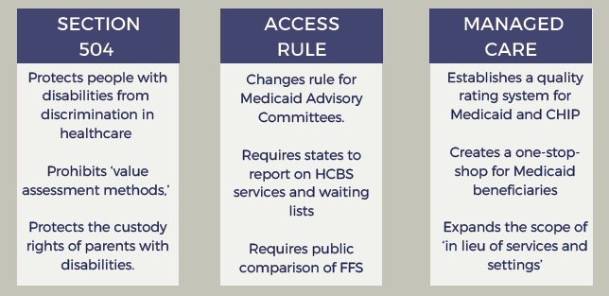

Slide 26
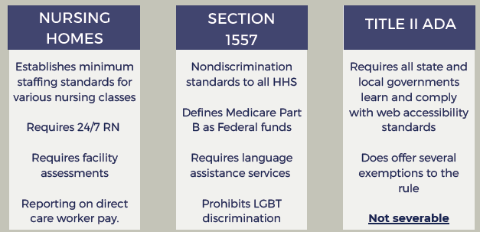

Slide 27
General Assembly Impact
Notes:
All new rules need approval from post-January 20, 2025 department/agency heads before issuance, though this power can be delegated and the OMB Director can exempt emergency cases or urgent deadlines.
Rules sent to the Federal Register but not yet published must be withdrawn for review, with same emergency exceptions applying.
Published or issued but not-yet-effective rules should undergo 60-day postponement for review, during which agencies can open comment periods and reassess petitions; further delays possible if needed.
After the 60-day review, rules without substantial questions need no action, while those raising concerns require OMB Director consultation.
"Rule" includes traditional rules (5 USC 551(4)), regulatory actions (EO 12866), guidance documents (EO 13891), notices of inquiry, advance notices, and agency statements of general applicability.
OMB Director oversees implementation, handles all related communications, and can review/act on pending Paperwork Reduction Act information collections.
Memorandum may be modified if pre-January 20, 2025 actions are found undermining its purpose; must be implemented within legal bounds.
CopyRetryClaude can make mistakes. Please double-check responses.https://www.whitehouse.gov/presidential-actions/2025/01/regulatory-freeze-pending-review/

Slide 28
Do KY Legislators mirror the president?
OR
Do they repair collateral damage?
Notes:
All new rules need approval from post-January 20, 2025 department/agency heads before issuance, though this power can be delegated and the OMB Director can exempt emergency cases or urgent deadlines.
Rules sent to the Federal Register but not yet published must be withdrawn for review, with same emergency exceptions applying.
Published or issued but not-yet-effective rules should undergo 60-day postponement for review, during which agencies can open comment periods and reassess petitions; further delays possible if needed.
After the 60-day review, rules without substantial questions need no action, while those raising concerns require OMB Director consultation.
"Rule" includes traditional rules (5 USC 551(4)), regulatory actions (EO 12866), guidance documents (EO 13891), notices of inquiry, advance notices, and agency statements of general applicability.
OMB Director oversees implementation, handles all related communications, and can review/act on pending Paperwork Reduction Act information collections.
Memorandum may be modified if pre-January 20, 2025 actions are found undermining its purpose; must be implemented within legal bounds.
CopyRetryClaude can make mistakes. Please double-check responses.https://www.whitehouse.gov/presidential-actions/2025/01/regulatory-freeze-pending-review/

Slide 29
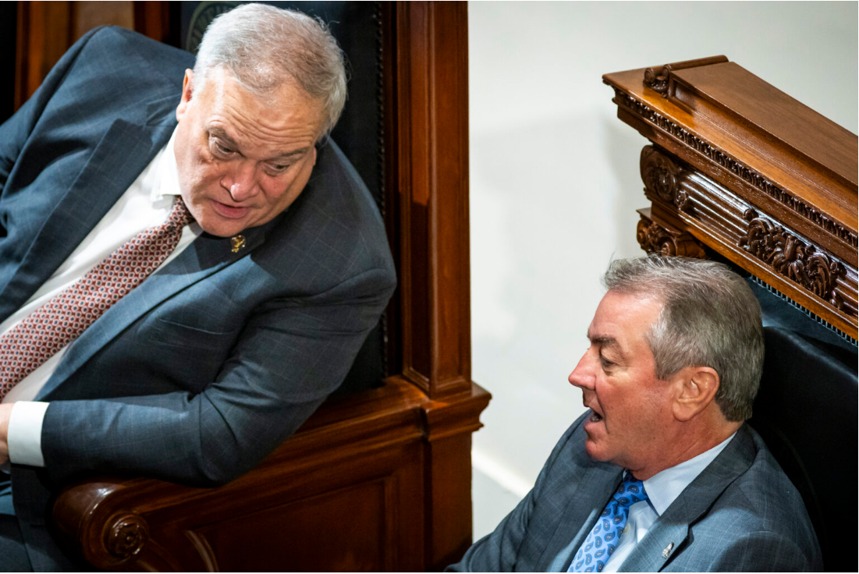
In Frankfort, Osborne told reporters Tuesday afternoon that state lawmakers “lay some groundwork to what happens, but we almost have to react to what happens on the federal level.”
“There’s obviously discussions about downsizing Medicaid, there’s discussions about dispersing the functions of the Department of Education,” Osborne said. “Those things obviously will affect us and impact us, and we will have to make policy about it, but it’s pretty difficult to make it in advance of.”

Slide 30
Stivers also said Kentucky lawmakers “have to be responsive to what they will allow or not allow” in regards to Medicaid changes at the federal level.
“We put up generally 30% of the Medicaid dollars they match with 70%, so the criteria around what they put up, then we can work within those guardrails would be one thing we look at and want to acknowledge,” Stivers said. “The other is the match rate. If they were to change the match rate, and that would impact us. So yes, we will — and we are — being very cognizant and watching what moves in Washington.”

